Slide 1

IEOR - 4578 FORECASTING “A real world application”
Project deliverable 2 – ONLINE RETAIL DATASET
Data prophets
Prakhar dungarwal (pd2782)
SOMIT JAIn (sj3396)
Shashwat Kumar (SK5520)
Devdatt Golwala (drg2172)

Slide 2
Problem Description
The online retail industry struggles with demand fluctuations, inventory mismanagement, and unpredictable customer behavior. Accurate forecasting is crucial to optimize stock levels, reduce cancellations, and improve revenue. This project leverages historical transaction data to uncover sales patterns and enhance forecasting accuracy.
Ultimately, the goal is to optimize sales forecasting for high-impact clusters to enable smarter inventory decisions and support data-driven planning during seasonal peaks.
1. Sales Forecasting: Used time series models (ARIMA, SARIMA, SARIMAX, Prophet, LSTM) on sales after data cleaning and stationarity analysis.
2. Product-Based Clustering & Forecasting: Clustered similar products (using BERTopic + UMAP + HDBSCAN) and applied GLM, Prophet, and LSTM on cluster-level sales to reduce noise and capture trends.

Slide 3
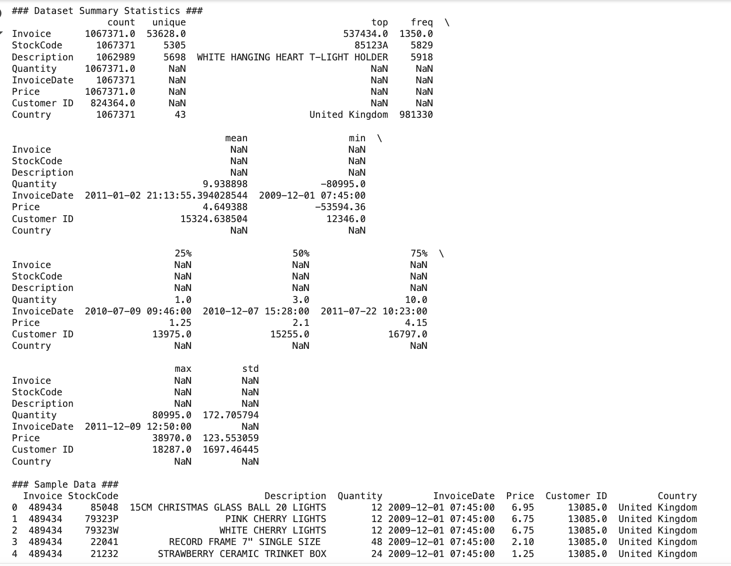
Dataset Description
The Online Retail II dataset contains two years of transactional data (2009–2011) from a UK-based e-commerce store selling household and gift items. The dataset includes
InvoiceNo
StockCode
Product Description
Quantity
Price
Customer ID
Country
This enables us for in-depth analysis of sales trends, best-selling products, customer purchase behavior, and cancellations.

Slide 4
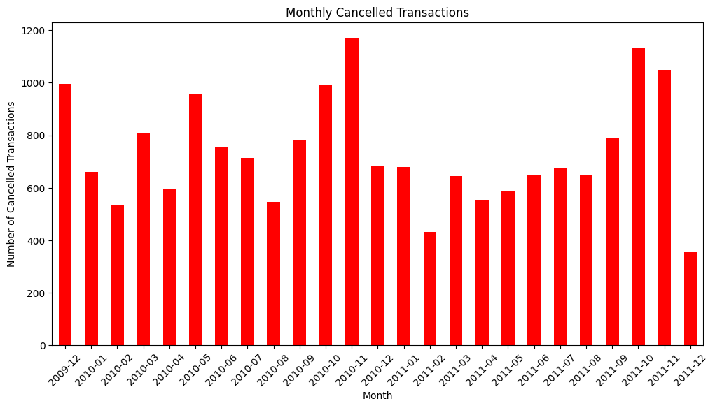
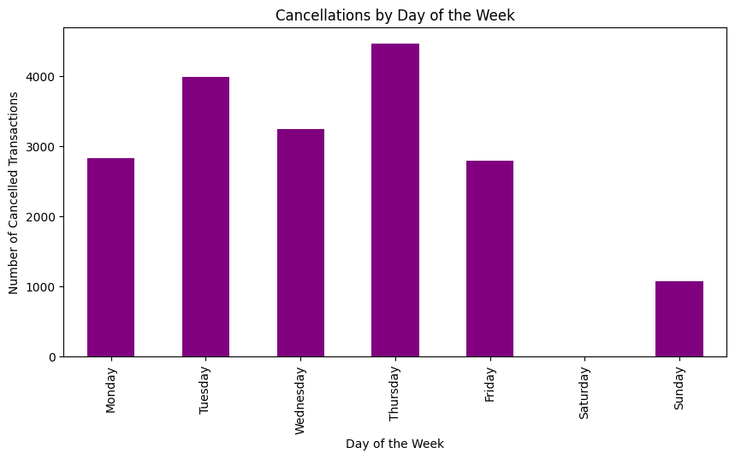
Data Exploration and Cleaning
The dataset contains 18,390 cancelled transactions, which can distort sales trends and impact forecasting accuracy. Monthly fluctuations and sharp peaks create false seasonality effects, making demand predictions unreliable. Most cancellations occur between 10 AM - 2 PM, likely due to order errors or stock issues. Cancellations also peak on Tuesdays and Thursdays, suggesting operational influences rather than genuine demand.
Removing cancelled transactions ensures that sales data reflects actual purchases, leading to more accurate forecasting, better inventory management, and improved business decisions.
Rows with missing Customer ID and Product Description were removed to ensure accurate customer and product-level analysis.
Duplicate transactions were dropped to prevent skewed insights and redundant data points.
Transactions with negative or zero Quantity and Price were removed, as they represent cancellations or data errors.
Converted Customer ID and StockCode to string format for consistency.
Transformed InvoiceDate into datetime format for time-series analysis.
Ensured StockCode contained only valid alphanumeric values, removing any special characters.
Eliminated placeholder or empty product descriptions to maintain meaningful data.
Initial Records: 1,067,371 → Cleaned Records: 779,394

Slide 5
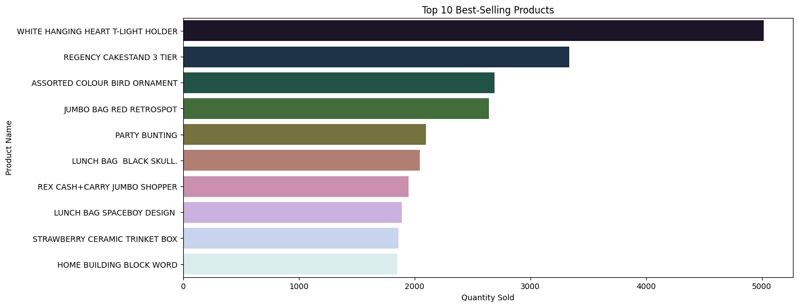
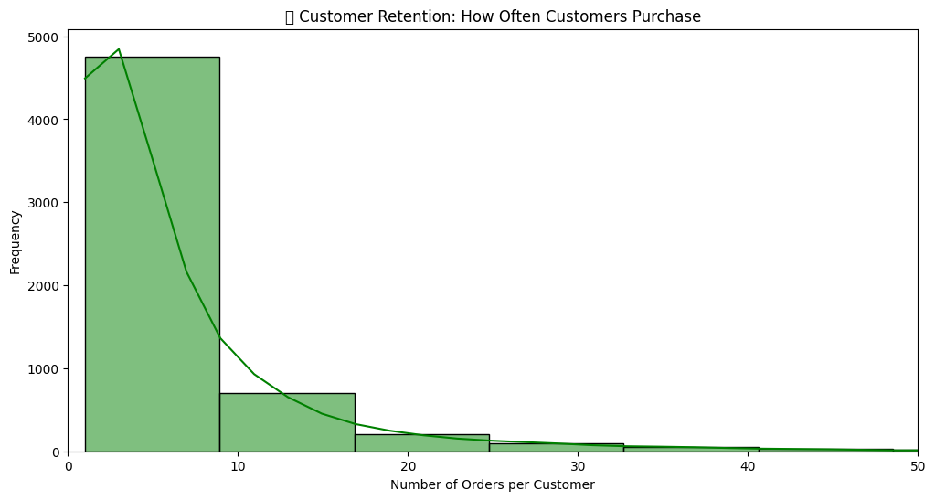
Exploratory Data Analysis
As we can see the Top 10 Best-Selling Products, with “WHITE HANGING HEART T-LIGHT HOLDER” leading in sales, followed by “REGENCY CAKESTAND 3 TIER” and “ASSORTED COLOUR BIRD ORNAMENT.”
The high demand for decorative and gift items highlights the importance of stocking and promoting these products to maximize sales.
This graph illustrates Customer Purchase Frequency, showing that most customers make only 1-5 purchases, while repeat buyers are rare.
This suggests low customer retention, emphasizing the need for loyalty programs, personalized offers, and targeted marketing to boost repeat sales.

Slide 6
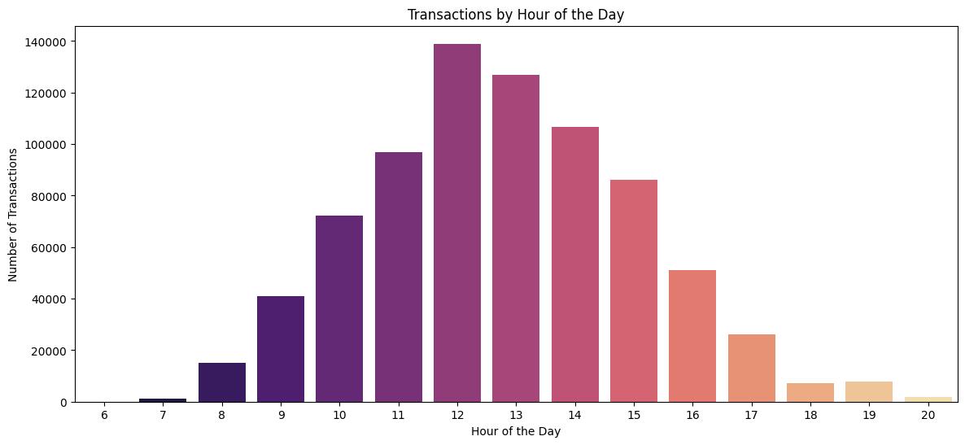
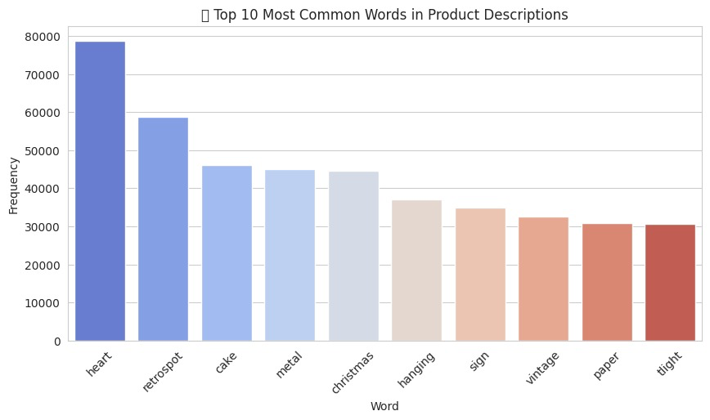
Exploratory Data Analysis
Transactions by Hour: Sales rise from 8 AM, peak at 12 PM, then decline after 3 PM, with minimal activity post 6 PM.
Midday is busiest, likely due to lunch breaks, helping businesses optimize staffing and promotions.
Top 10 Common Words: “Heart” appears most (80,000 times), indicating many heart-themed products. “Retrospot” and “cake” suggest vintage and cake-related items.
Other frequent words like “metal,” “Christmas,” and “hanging” point to decorations.
Terms like “sign,” “vintage,” and “paper” reflect signage, retro goods, and packaging trends.

Slide 7
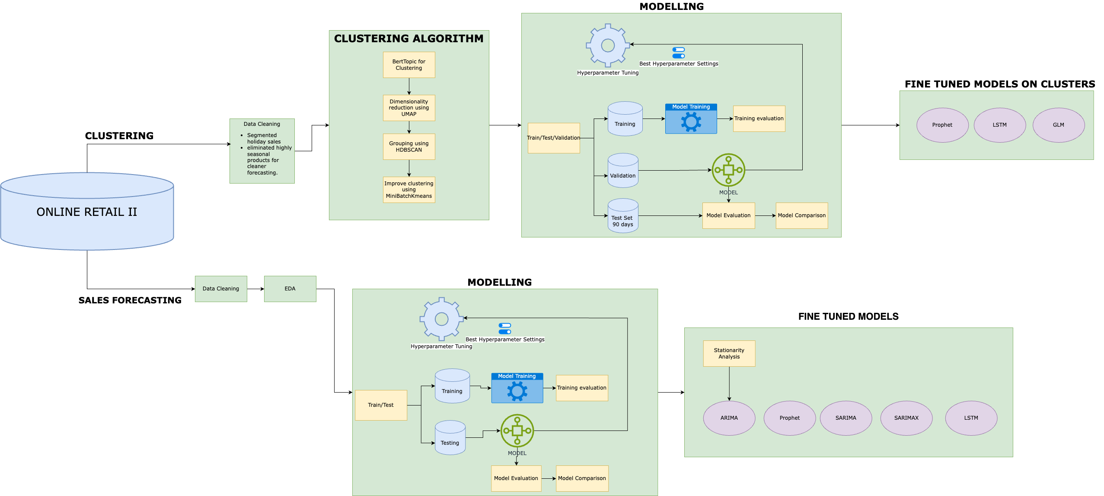
Architecture

Slide 8
Clustering Products Intuition
The first step was data cleaning—removing missing values, filtering invalid sales, and preprocessing text by converting to lowercase, removing special characters, and eliminating stopwords.
We used BERTopic for clustering, first converting product descriptions with TF-IDF, then optimizing with SBERT for better embeddings.
After clustering, we assigned each product a cluster, analyzed key themes, and visualized relationships using bar charts and heatmaps.
We improved clustering with MiniBatchKMeans, a faster K-Means variant, ensuring accuracy and assigning meaningful labels based on key words.
We used UMAP to reduce dimensionality for better clustering, then applied HDBSCAN, which automatically grouped similar products without presetting the number of clusters.

Slide 9
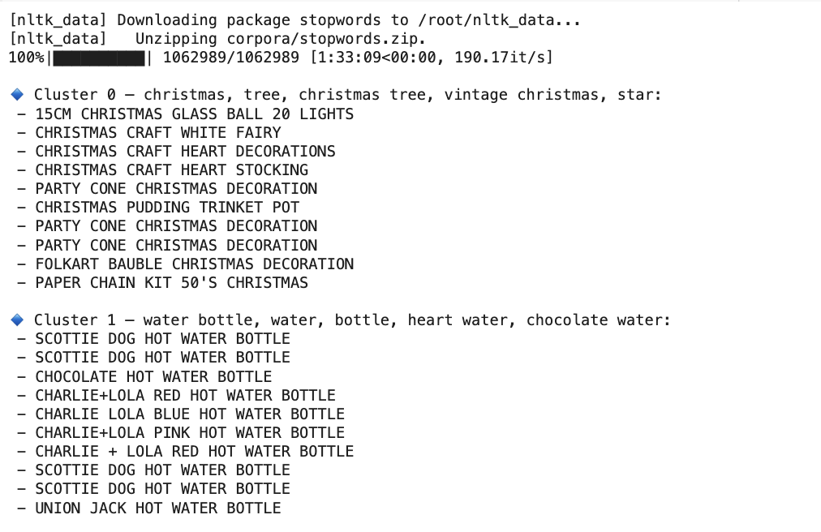
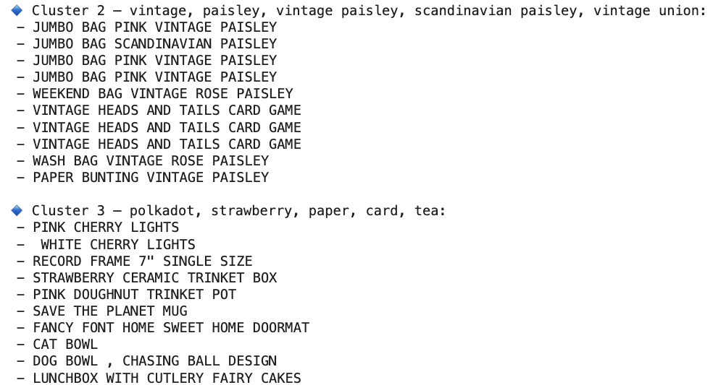
Final Product Clusters

Slide 10
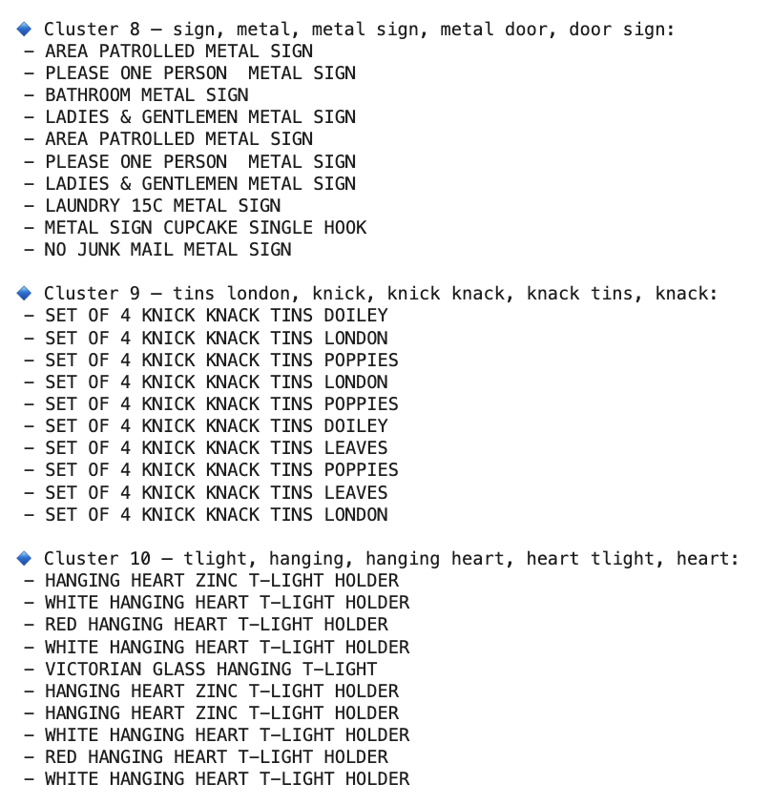
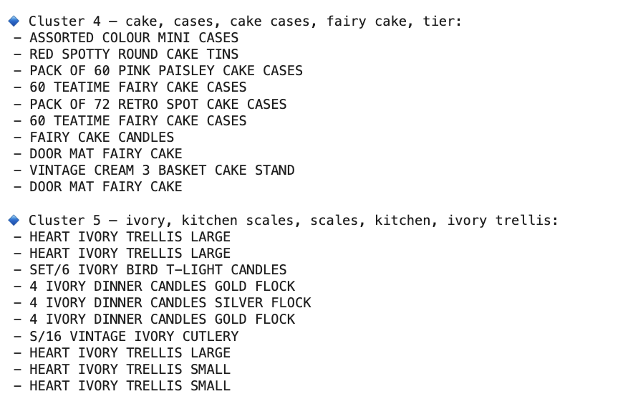
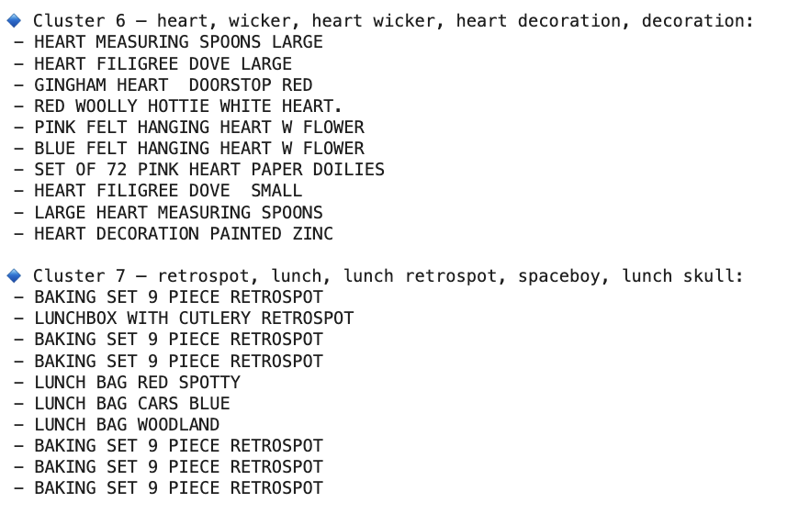
Final Product Clusters

Slide 11
Modelling on Clusters
Targeted Data Cleaning
Dropped NAs, duplicates, and cancelled orders to keep only valid transactions.
Filtered for positive quantity and price to eliminate returns and data entry errors.
Standardized data types and cleaned StockCodes to ensure consistent product identification.
Removed low-selling products and price outliers to reduce noise and prevent skewed clusters.
Excluded holiday-only sales spikes to avoid seasonal bias in clustering.
Created a TotalSales feature to incorporate monetary value in clustering decisions.
Modelling strategy
In all our models we have followed a 90-day testing size and inbuilt cross validation to tune the hyperparameters for each of models i.e Prophet, LSTM and GLM.
Our box plots, based on the 90-day test set divided into four regions, illustrate the forecast error distribution (Actual – Predicted) across those regions.
We selected three key product clusters—Clusters 1, 5, and 7—focused on Cozy Essentials, Party Supplies, and Rustic Decor for targeted sales forecasting.

Slide 12
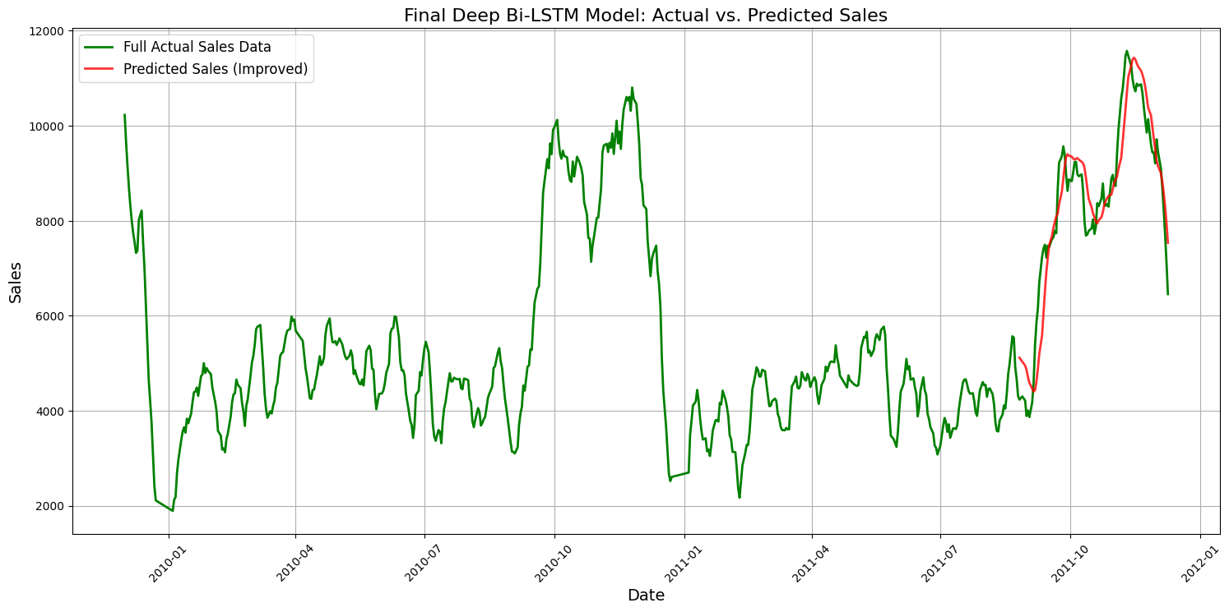
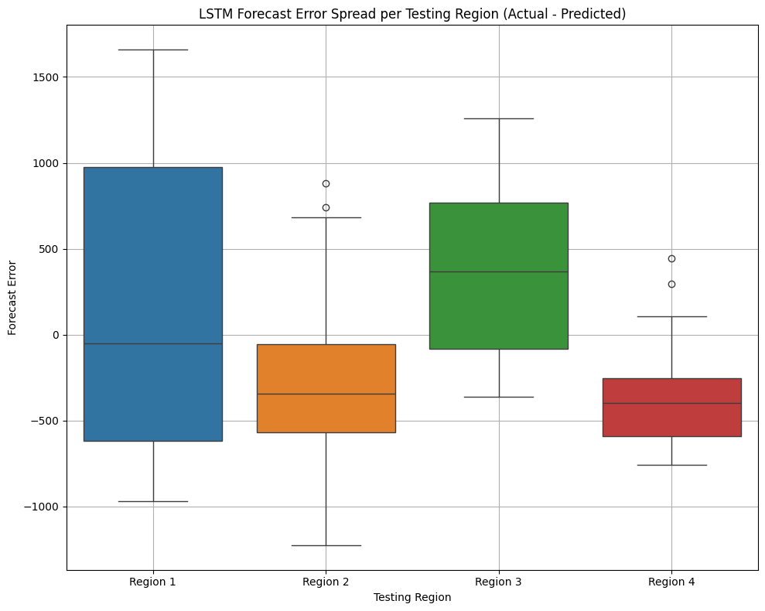
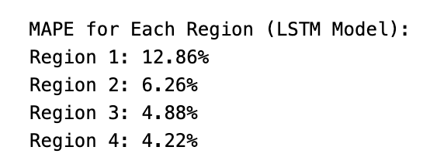
Modelling on Cluster ~ LSTM
We used daily sales data from a product cluster (after clustering similar items).
Sales were cleaned, smoothed, and normalized to remove noise and make the patterns clearer.
The model has 3 Bi-Directional LSTM layers (256 → 128 → 64 units)
Dropout layers (0.15) are added to prevent overfitting
Final Dense layers generate the predicted sales value
Why This Works
Bi-LSTM reads patterns forward and backward in the data
Smart training strategies (callbacks, dropout, tuning) lead to better accuracy and less overfitting
Final model performs well in predicting real future sales trends with a MAPE of 7.21%

Slide 13
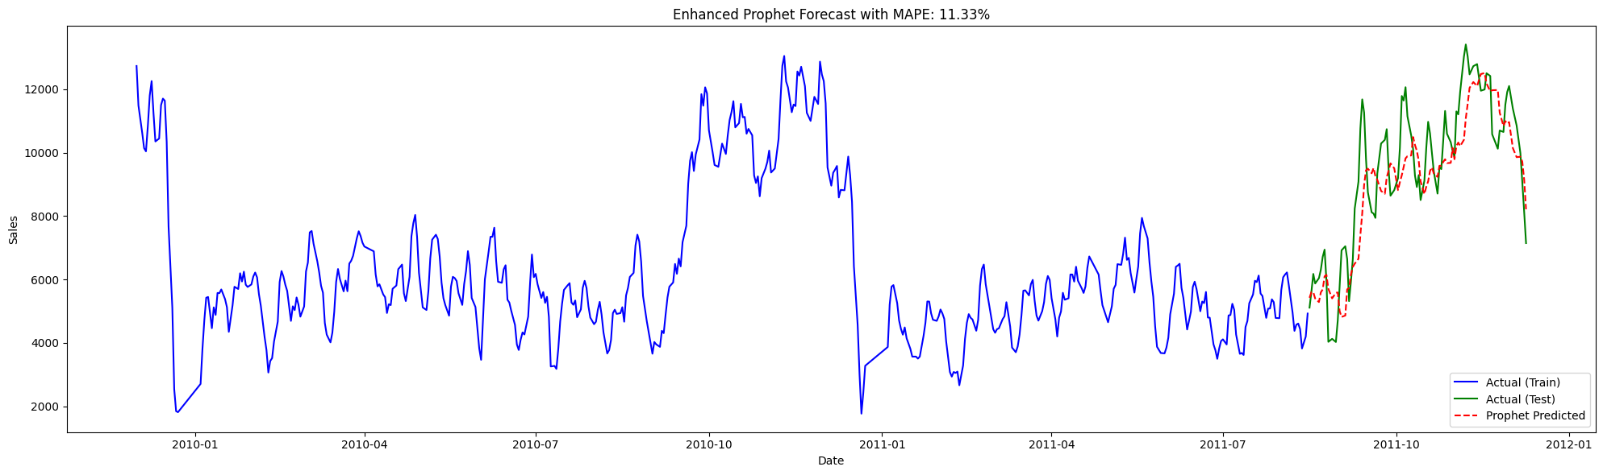
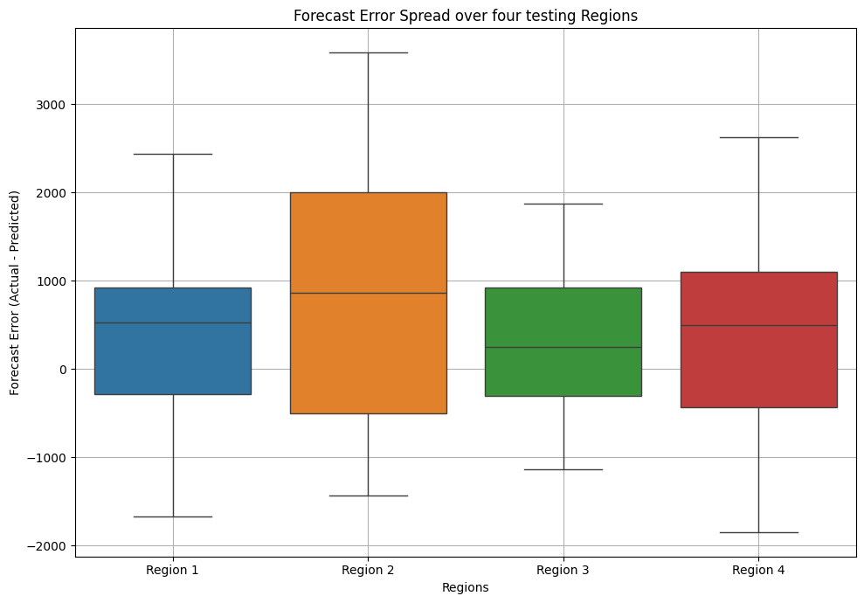
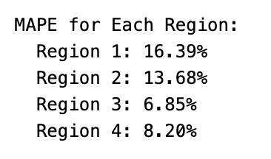
Modelling on Clusters ~ Prophet
Aggregated total sales per day
Applied Savitzky-Golay smoothing and Exponential Weighted Moving Average
Used Prophet’s built-in trend + seasonality features
Added custom yearly seasonality using Fourier terms
Tuned key hyperparameters using cross-validation for better performance
Why This Works?
Handles seasonality, holidays, and trend shifts automatically
Final MAPE of 11.33%

Slide 14
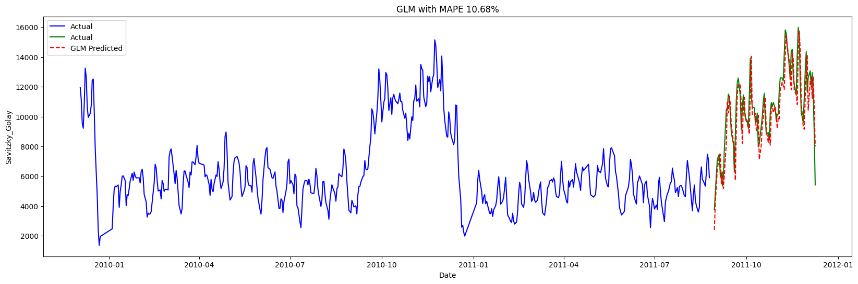
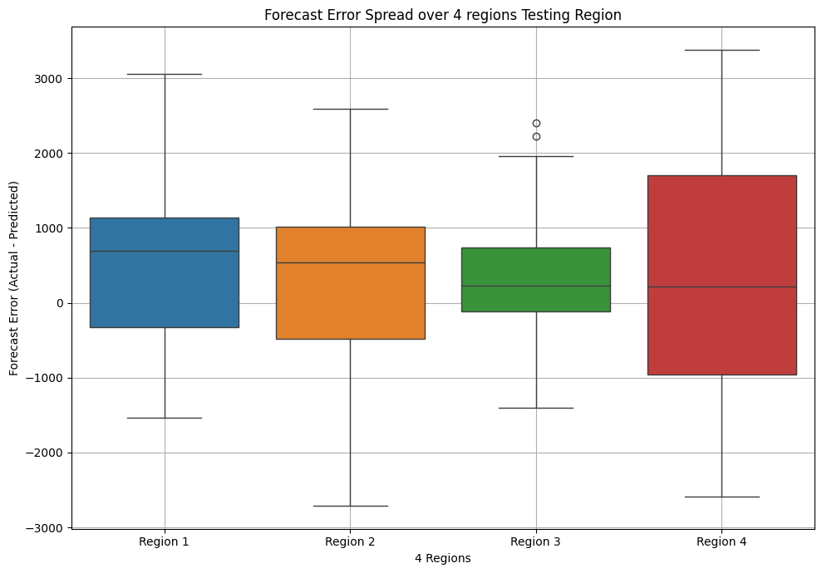
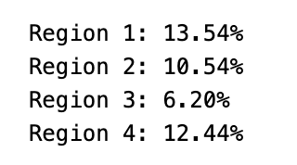
Modelling on Clusters ~ GLM
Cleaned and smoothed the daily sales using Savitzky-Golay filtering
Used GLM with Gaussian distribution to model continuous sales data
Added a constant term to account for intercept
Trained the model on lagged features to learn sales patterns
Why GLM works?
Fast and lightweight, making it easy to train for each cluster
Interpretable, so we can understand how much recent sales influence future demand
A good baseline model, especially when demand is stable or follows repeated short-term patterns
Final MAPE: 10.68%

Slide 15
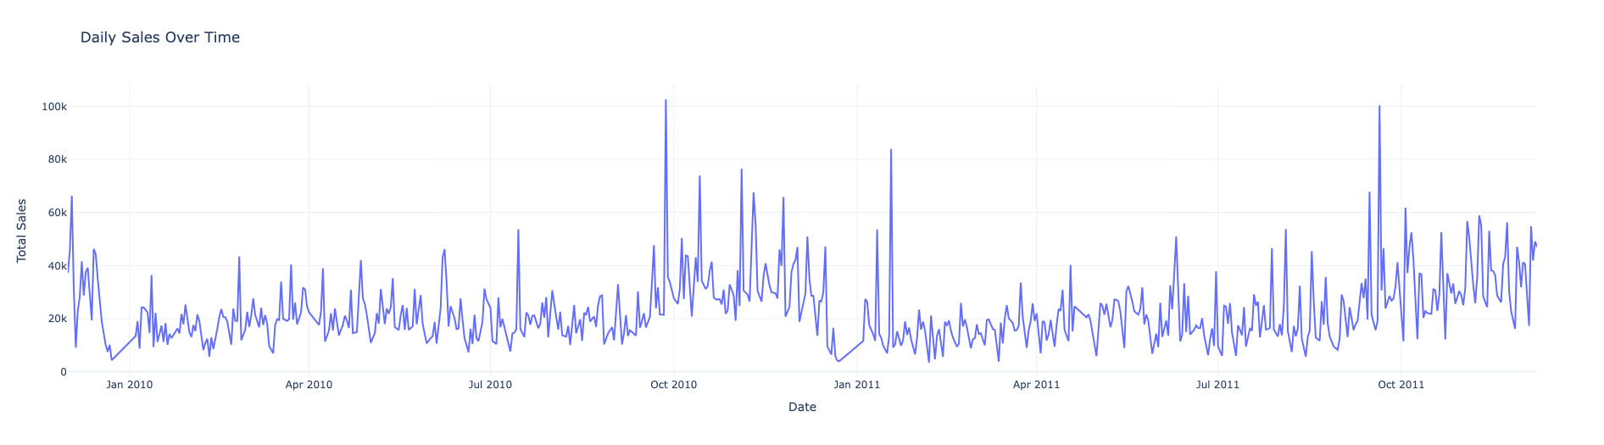
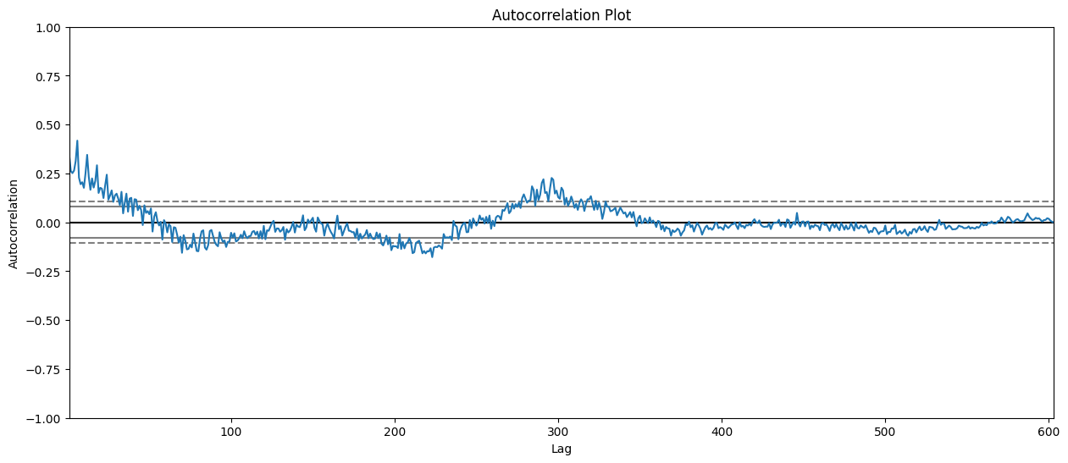
Sales Trends and Autocorrelation
This figure shows daily sales from early 2010 to late 2011, highlighting significant fluctuations and periodic spikes, likely due to seasons, promotions, or events.
Sales volatility increases over time, suggesting growth or rising variability.
The autocorrelation plot shows how past sales impact future sales. Initially strong, this effect fades over time.
The pattern suggests seasonality, with alternating highs and lows.
The dip into negatives indicates high sales days may be followed by lower sales. Dashed lines mark statistically significant correlations.

Slide 16
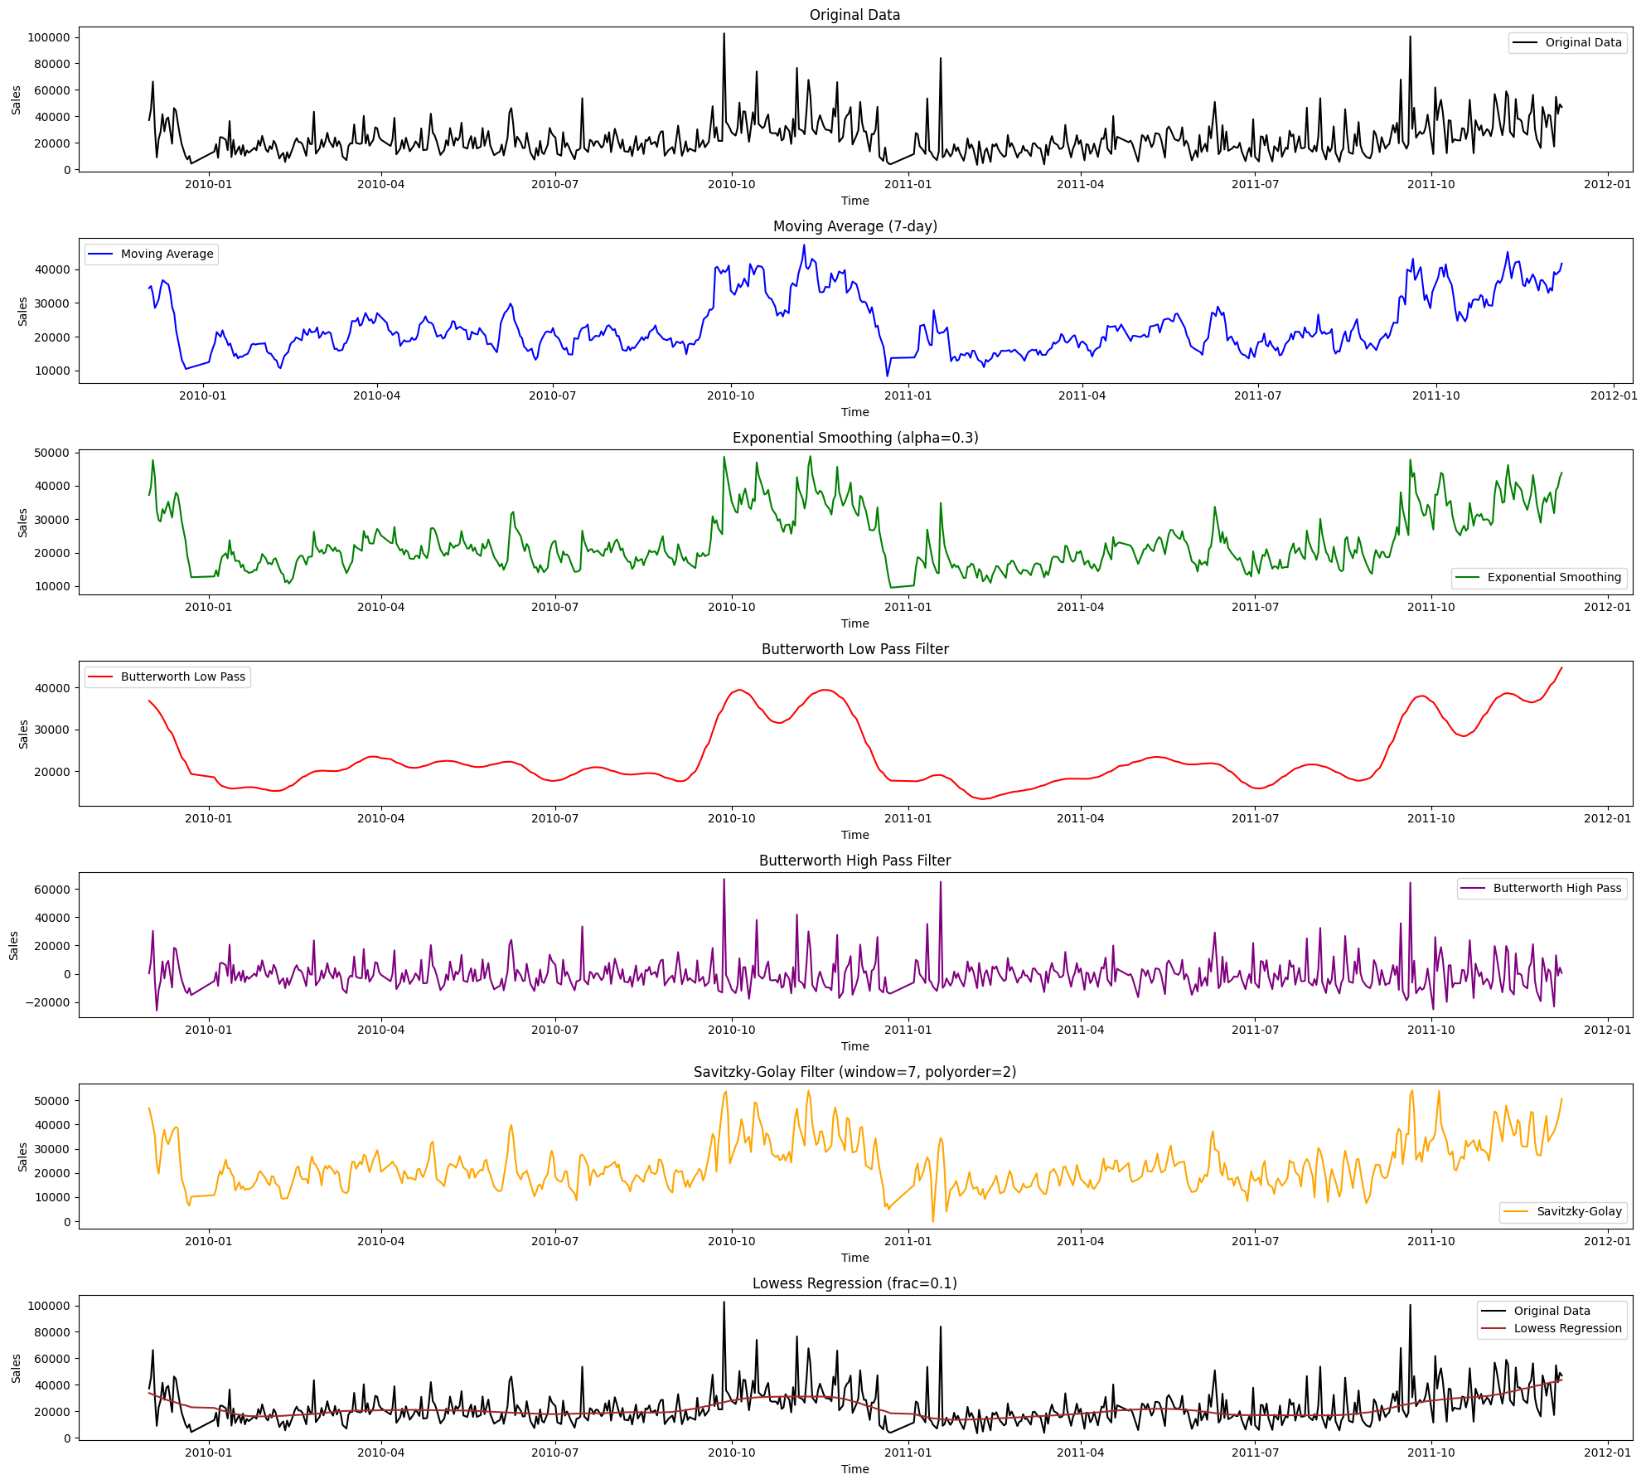
Smoothing
This figure illustrates different methods for analyzing and smoothing daily sales data. The original data (black line) shows raw sales with fluctuations. To highlight trends, various smoothing techniques are applied.
• Moving Average (blue): Averages sales over seven days, reducing short-term noise.
• Exponential Smoothing (green): Weights recent values more, making it responsive to changes.
Butterworth Filters:
Low-pass (red): Captures long-term trends by filtering short-term fluctuations.
High-pass (purple): Isolates short-term variations, highlighting sudden changes.
Savitzky-Golay (yellow): Smooths data while preserving key patterns.
Lowess Regression (black trend): Provides a flexible smoothed trend line.

Slide 17
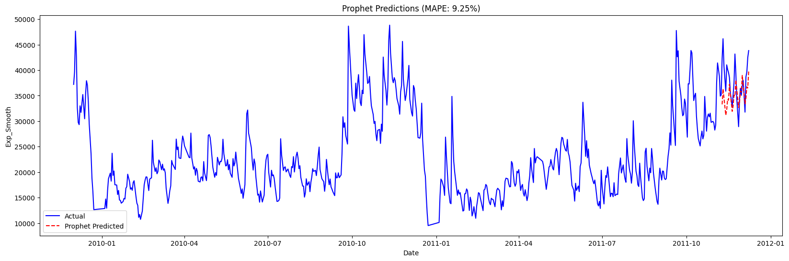

Time series Modelling
The Prophet model predicts sales with the actual sales shown in blue and the predicted values in red dashed lines.
It follows the overall trend well but has some small errors, especially in peaks and dips. The MAPE (Mean Absolute Percentage Error) is 9.25%, meaning the predictions are fairly accurate with minor deviations.
The GLM (Generalized Linear Model) also forecasts sales, with actual sales in blue and predictions in red dashed lines.
It closely follows the real trend and has slightly better accuracy than Prophet. The MAPE is 9.02%, showing that it makes fewer errors.

Slide 18
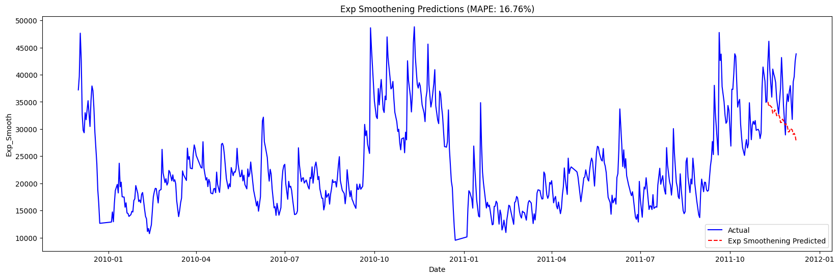
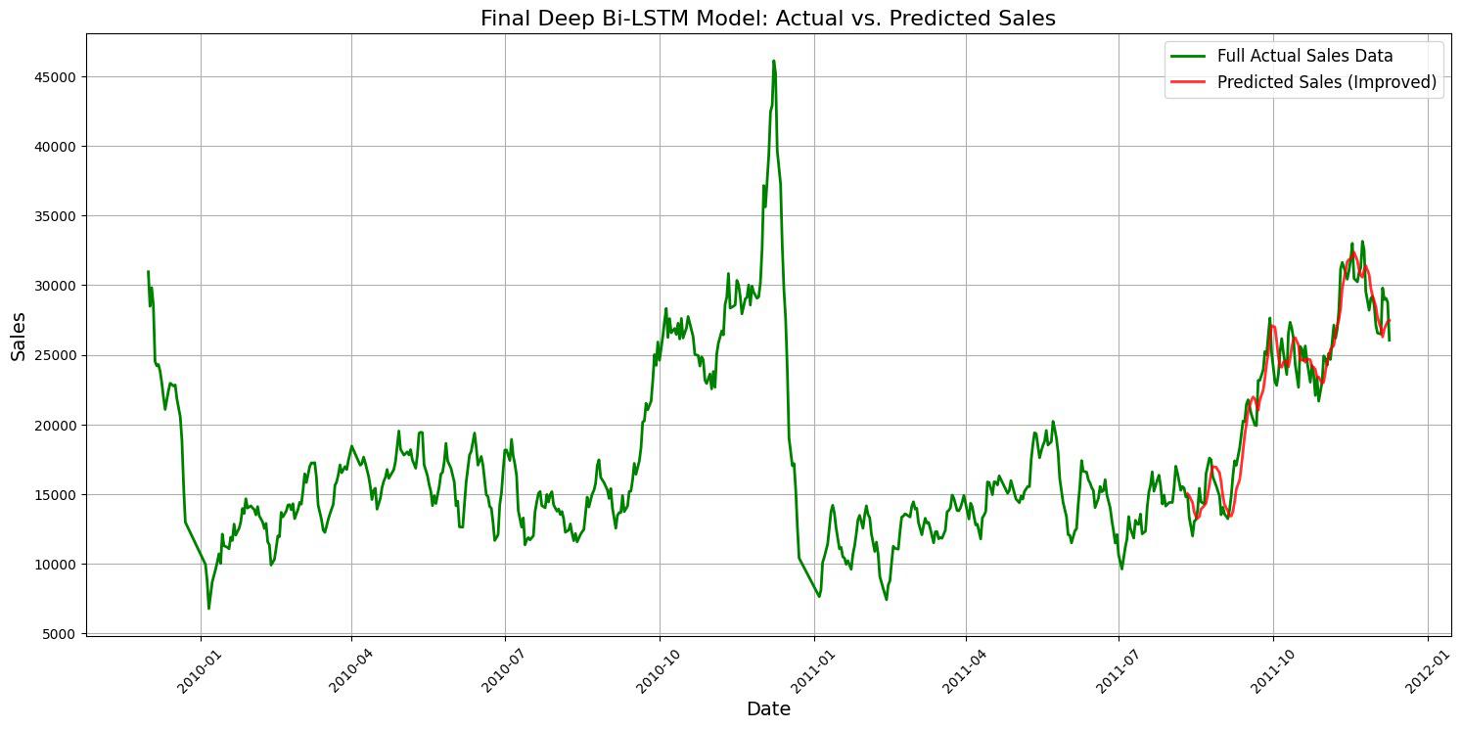
Time series Modelling
Exponential Smoothing captures overall trends but struggles with sudden spikes and drops. The predictions follow the general pattern but miss short-term fluctuations, making them less reliable for highly variable sales data.
With a MAPE of 16.76%, the error rate is relatively high, meaning the model is not the best for short-term forecasting.
The Bi-LSTM model learns from past sales patterns and provides more accurate predictions by closely following actual sales trends.
It captures both gradual changes and sharp fluctuations, making it a better choice for forecasting. The model adapts well to complex patterns, producing more reliable and precise predictions.

Slide 19
Conclusion
We analyzed sales trends and customer behavior using forecasting and clustering. BERTopic and MiniBatch K-Means helped create meaningful product clusters, improving segmentation and revealing key demand patterns.
We compared Prophet, GLM, Bi-LSTM, for time series forecasting. Bi-LSTM was the most accurate, capturing trends and fluctuations, while Prophet and GLM performed well overall. Exponential smoothing identified long-term trends but struggled with short-term variations.
Our analysis showed high sales volatility with seasonal spikes from promotions or events. Autocorrelation confirmed seasonal patterns, while smoothing techniques like moving averages and Lowess regression improved trend visibility by reducing noise.
Overall, this project demonstrated the effectiveness of clustering and forecasting in understanding sales behavior. By combining product-based segmentation with time series modeling, we provided actionable insights for inventory management, demand forecasting, and business strategy.

Slide 20
Thank you

